Slide 1
Digital Portfolio
STUDENT NAME: D.PREETHI
REGISTER NO AND NMID:asunm163u24ca228
DEPARTMENT: BCA
COLLEGE & UNIVERSITY: HINDUSTAN COLLEGE OF ARTS AND SCIENCE, UNIVERSITY OF MADRAS

Slide 2
PROJECT TITLE
Student Digital Portfolio using Frontend Development

Slide 3


AGENDA
Problem Statement
Project Overview
End Users
Tools and Technologies
Portfolio design and Layout
Features and Functionality
Results and Screenshots
Conclusion
Github Link
3/21/2024 Annual Review

Slide 4

PROBLEM STATEMENT
In today’s digital era, traditional resumes are not enough to showcase skills and projects effectively. Many students and professionals lack a structured online presence to highlight their work. A digital portfolio provides an interactive and accessible platform to present achievements, skills, and experiences in a professional way.

Slide 5

PROJECT OVERVIEW
A personal digital portfolio built using frontend technologies.
Contains sections such as About Me, Projects, Skills, and Contact.
Main objective: Showcase achievements, technical skills, and completed projects in a professional and engaging format.

Slide 6

WHO ARE THE END USERS?
Students – to present academic projects and resumes.
Job Seekers – to share portfolios with recruiters.
Freelancers – to showcase work samples to clients.
Professionals – to highlight expertise and achievements.

Slide 7

TOOLS AND TECHNIQUES
HTML – Structure of pages and sections.
CSS – Styling, colors, layouts, and responsiveness.
JavaScript – Interactivity, animations, and form validation.

Slide 8
POTFOLIO DESIGN AND LAYOUT
Home/About Me – Introduction and background.
Projects – Display of academic and personal projects with details.
Skills – Technical and professional skillset overview.
Contact – Contact form for communication.
Responsive Design – Optimized for both desktop and mobile devices.
8

Slide 9
FEATURES AND FUNCTIONALITY
Interactive navigation bar with smooth scrolling.
Project showcase with images, descriptions, and links.
Engaging UI with hover effects and animations.
Functional contact form with validation.
Fully responsive design across all devices.

Slide 10
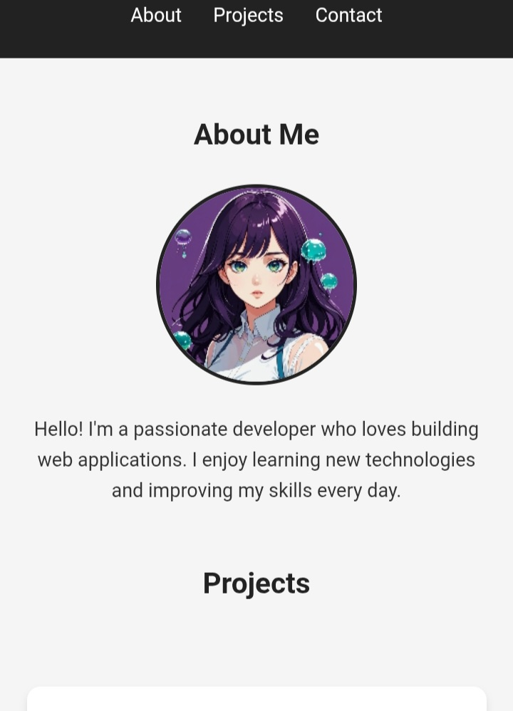
RESULTS AND SCREENSHOTS
Successfully created a professional portfolio.
Demonstrated technical skills in HTML, CSS, and JavaScript.
Responsive and interactive design enhances user experience.
3/21/2024 Annual Review
‹#›

Slide 11
CONCLUSION
The digital portfolio provides a modern and professional way to showcase skills and projects. It helps students, job seekers, and professionals establish a strong online presence and improve career opportunities.
Github Link:
11

